Slide 1

Build Recommender System in Python Using Google Colab

Slide 2
OBJECTIVE
Guide to use Google Colab
Simple Idea of getting data from website
Building a simple recommendation system in python

Slide 3
Google Colab - Free Cloud Based Jupyter Notebook
Offers 12 gb of free RAM which can be extended to 25 gb
Free GPU for machine learning and deep learning project
Free Cloud service with free GPU
Kernels for both R and Python
Ease of collaboration – make comments and share like google docs
Connect to GitHub, Kaggle and Google Drive
PRO VERSION: 10 dollars a month offers more RAM,
Faster GPU, and more run time.

Slide 4
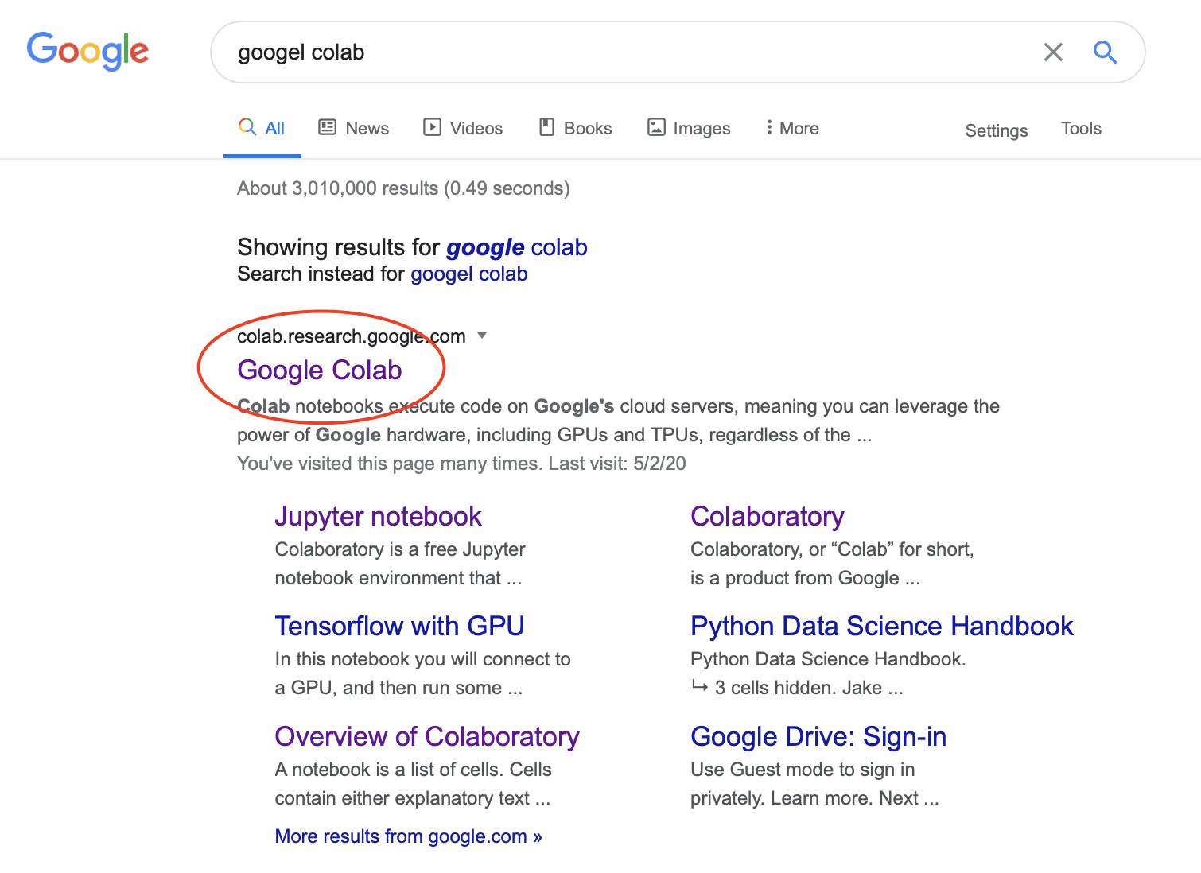
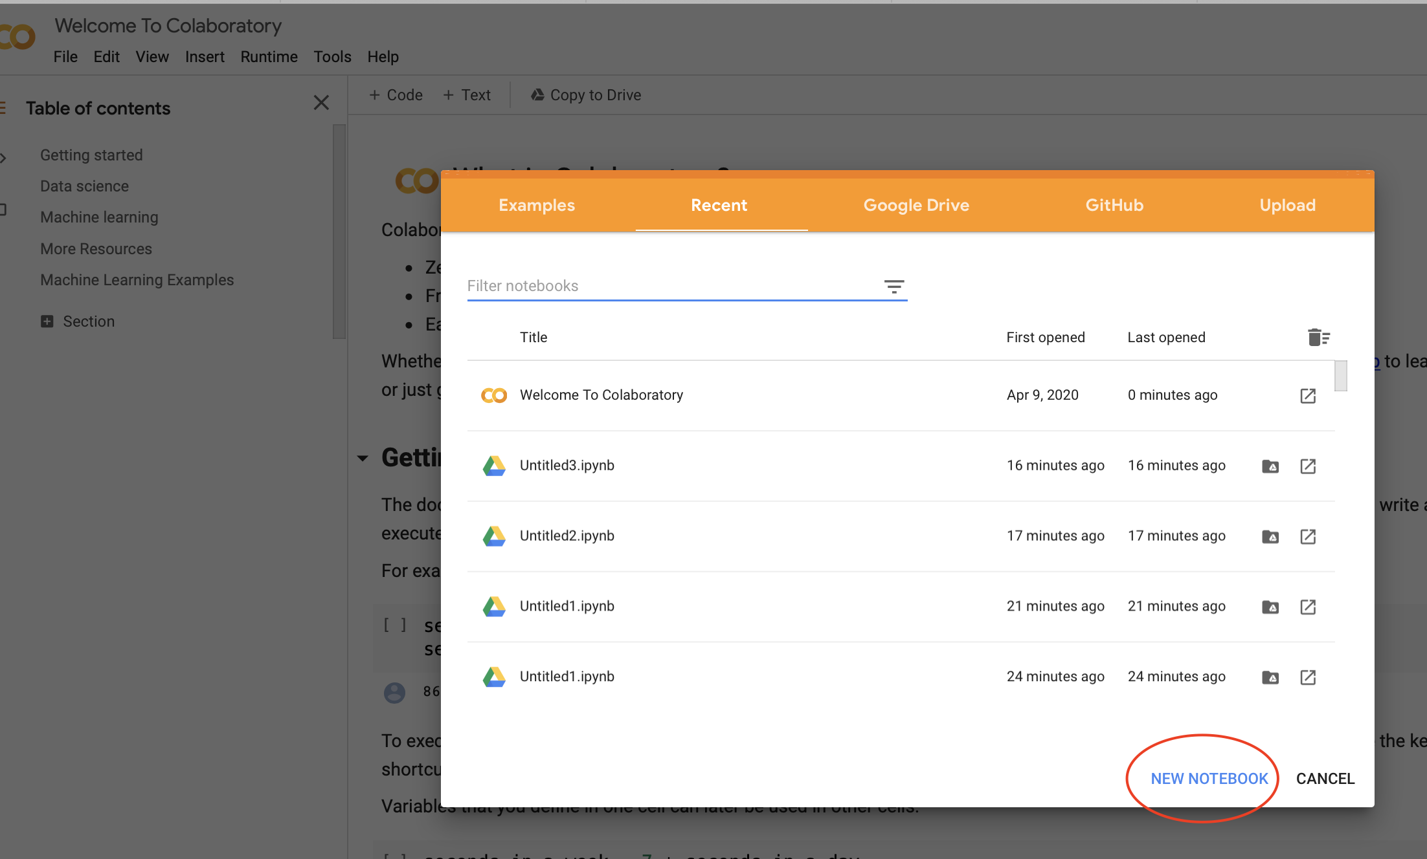
Starting for Google Colab

Slide 5
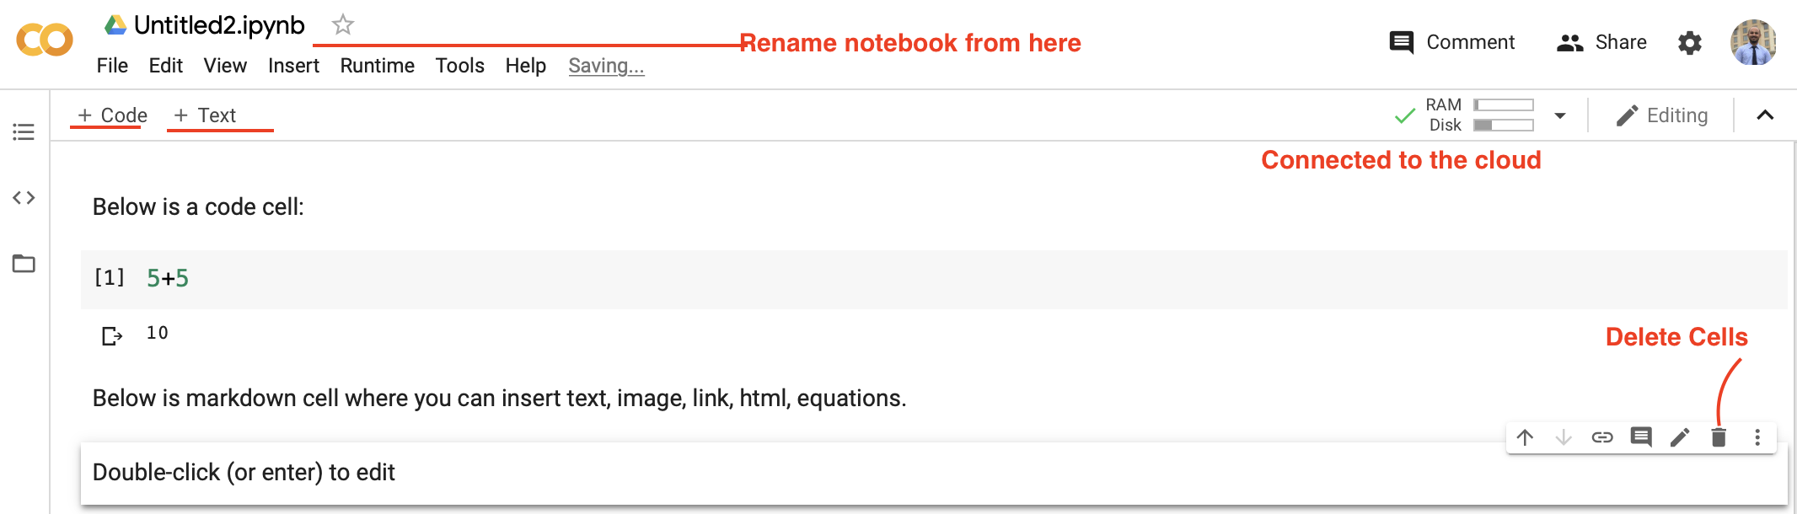
Google Colab – An example of notebook
You can run your python codes (+code) and add text in markdown cells (text)

Slide 6
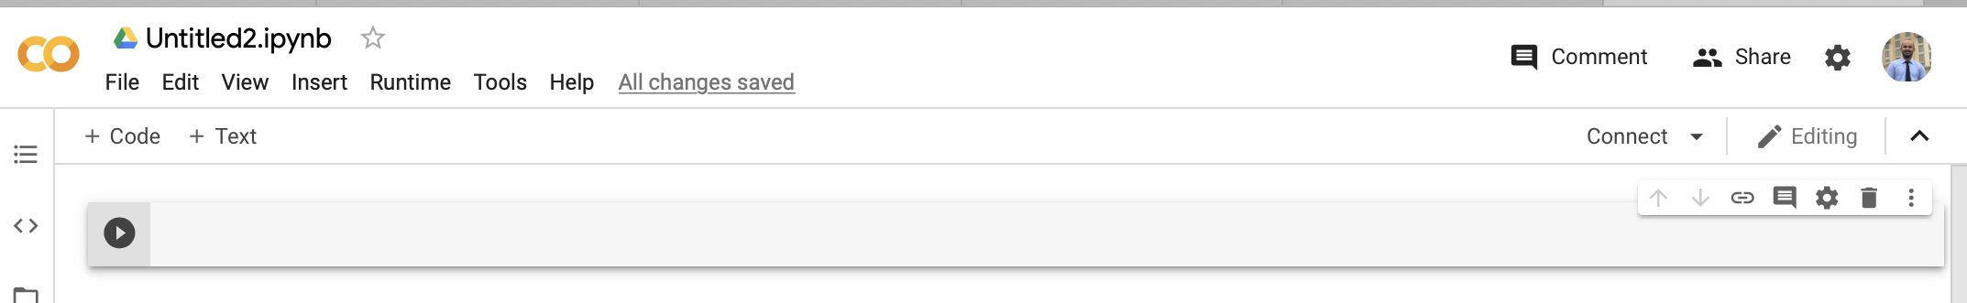
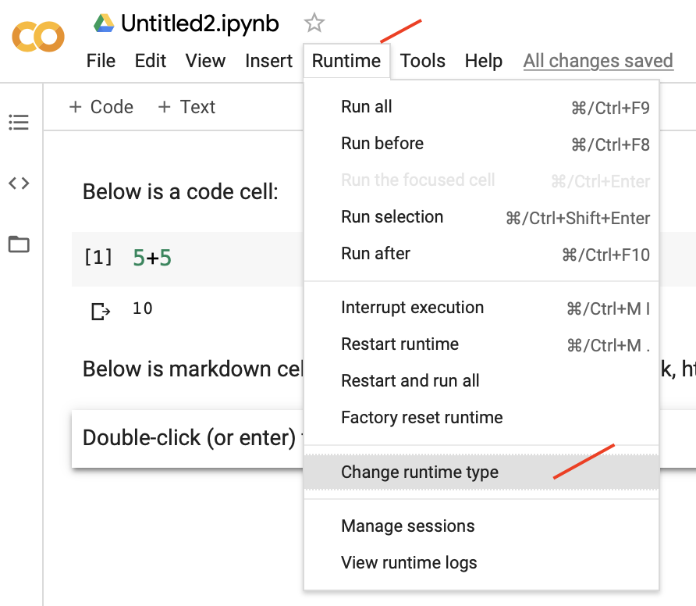
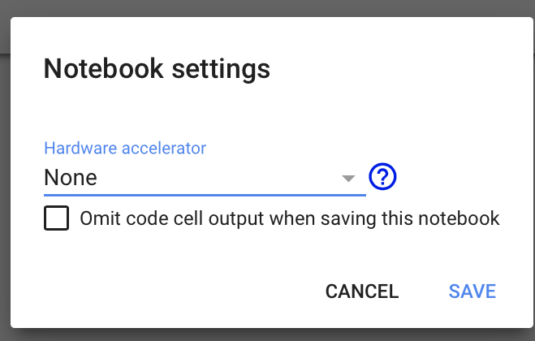
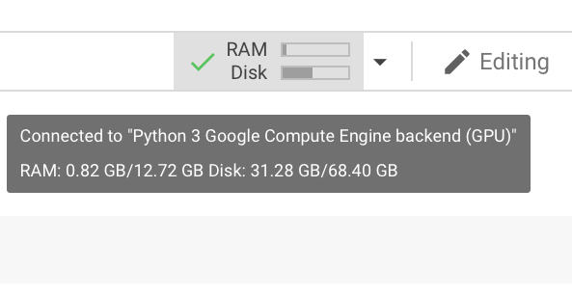
Google Colab – Connect to GPU

Slide 7
DEMO – VIDEO Google Colab - Your First Colab Notebook es
Please copy and paste the link on the browser to see the tutorial video.
https://youtu.be/OOpLBlnSLTY

Slide 8
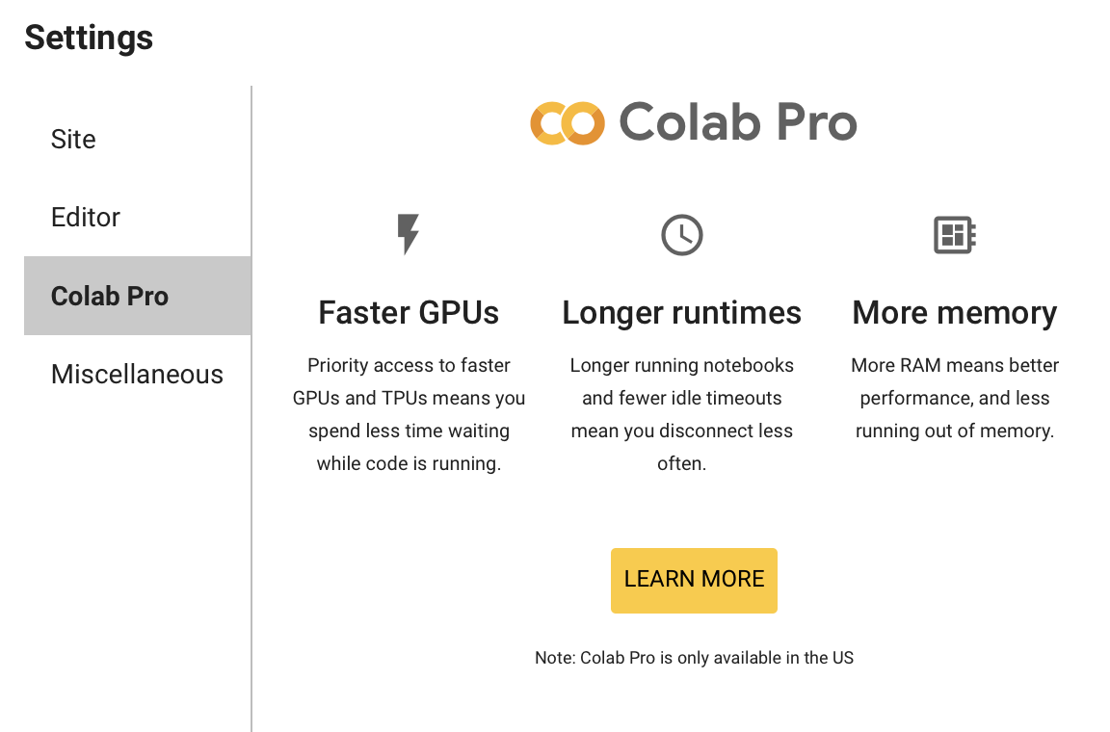
Google Colab Pro
10 dollars per month

Slide 9
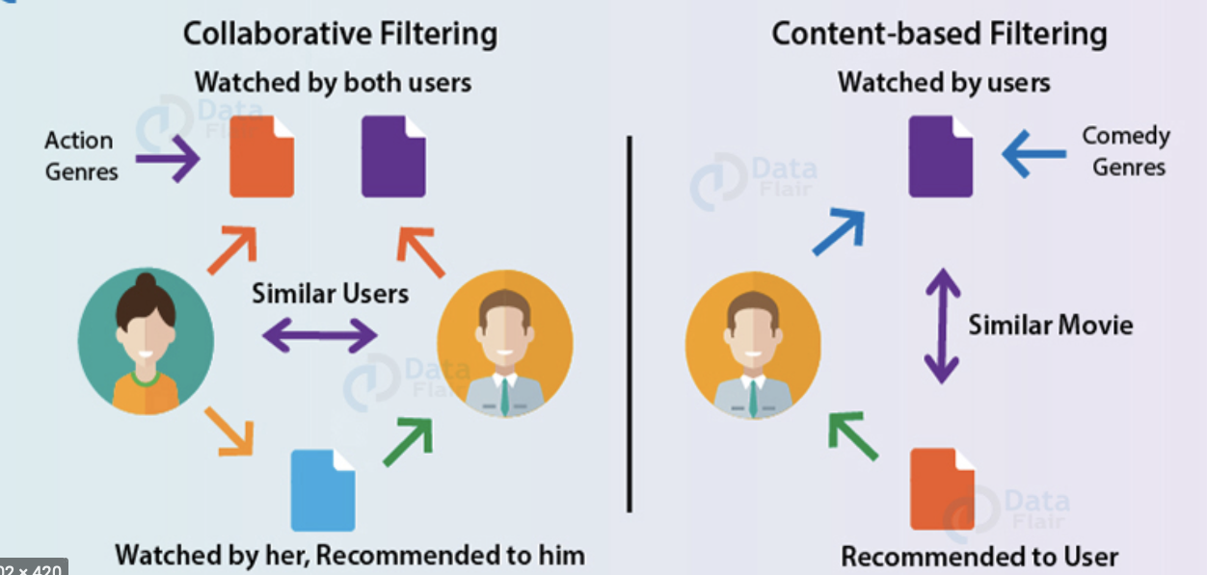
Recommender System
https://data-flair.com
Recommender Systems are a class of AI systems that predict and recommend new items (e.g. YouTube videos, Netflix shows, Amazon products).

Slide 10
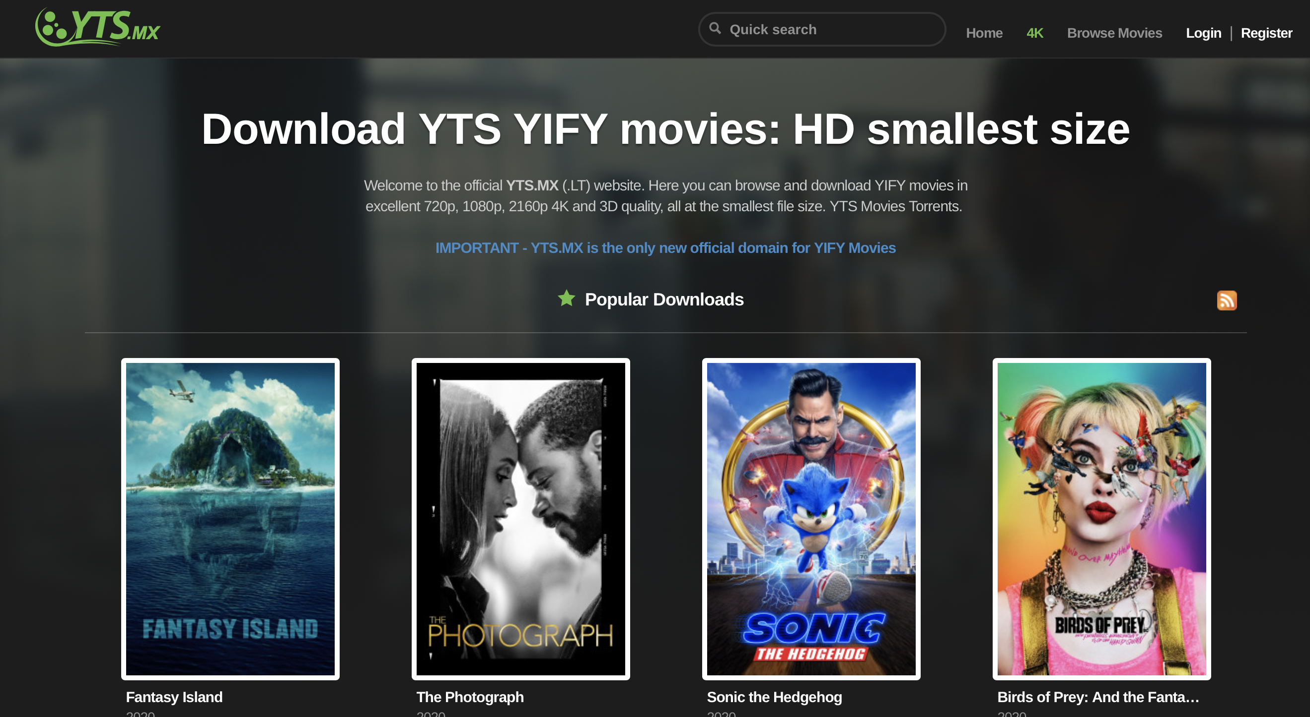
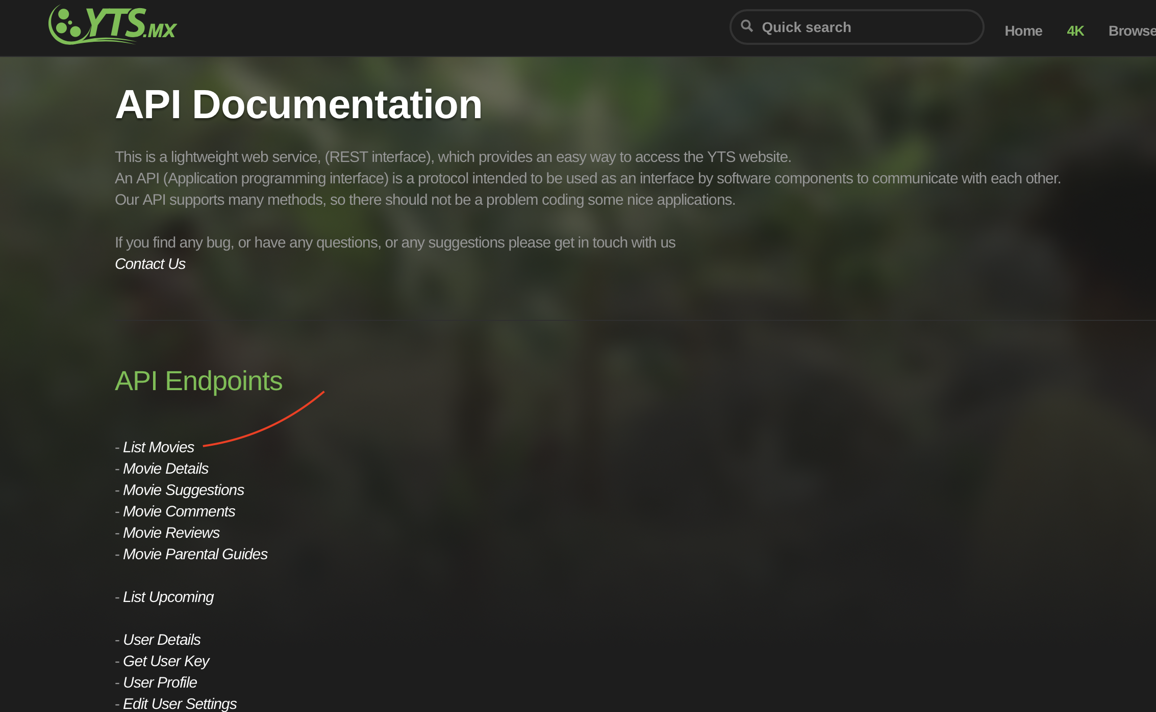
Data – gather recent movie data to build content recommender system
Data was scraped from Application programming interface(API) of YTS.mx

Slide 11
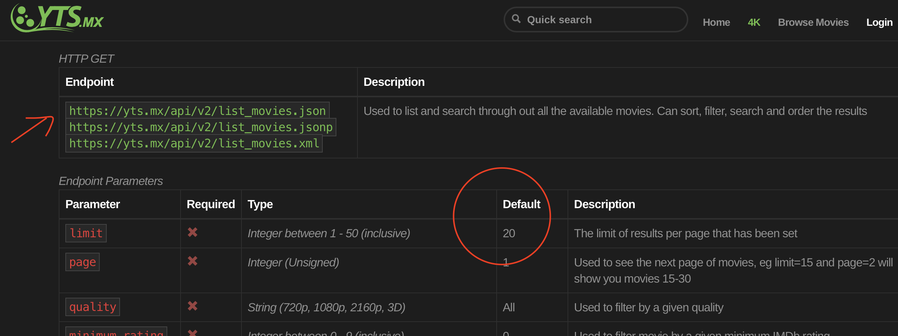
Scrapping data from API forming a loop
https://yts.mx/api#list_movies
Json file had limitation of 20 data points.

Slide 12
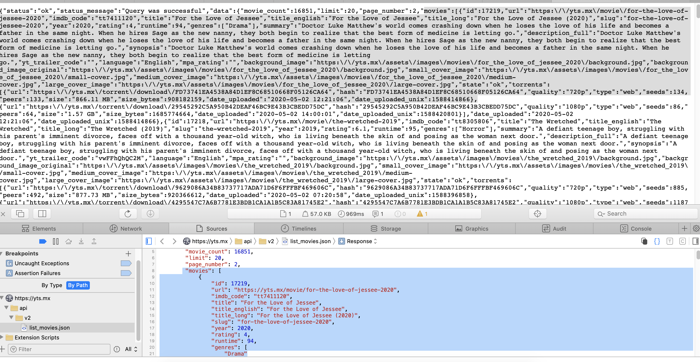
I wanted movie dataset array from list of movies
Open the json file link--→ Right click on the page-→ inspect

Slide 13
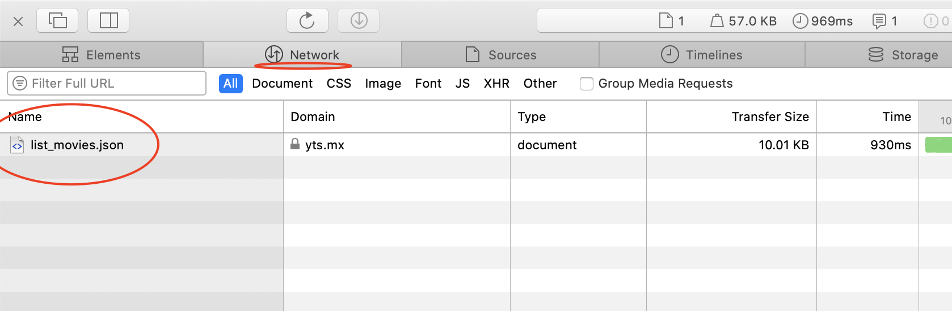
Download json file from here

Slide 14
Limited data in each json file for a page
https://yts.mx/api/v2/list_movies.json?page=2
Each json file had limitation of 20 dataset per page
Require some system to loop over all the pages and scrape data from API

Slide 15
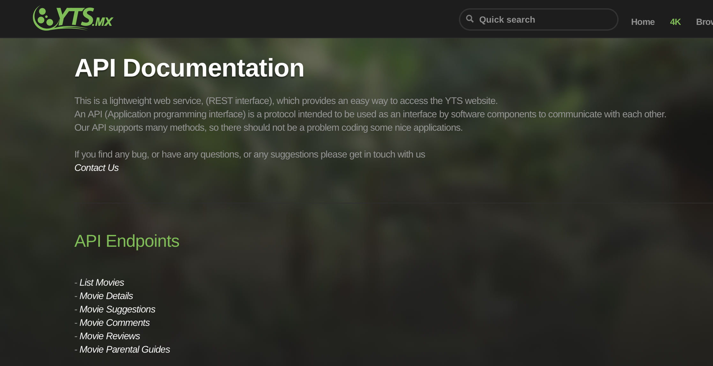
Scraping video
HOVER OVER THE VIDEO AND CLICK ON PLAY BUTTON
Please copy and paste the link on the browser to see the tutorial video.
https://youtu.be/QMPsPrK0MDo

Slide 16
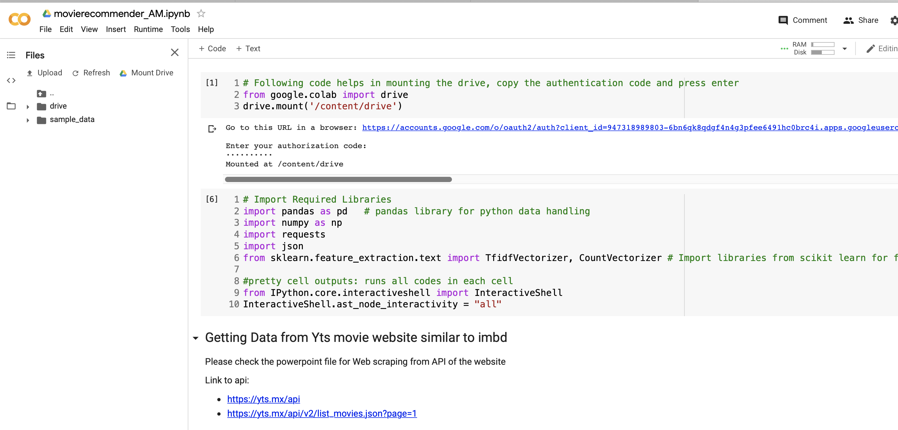
Start coding in Google Colab

Slide 17
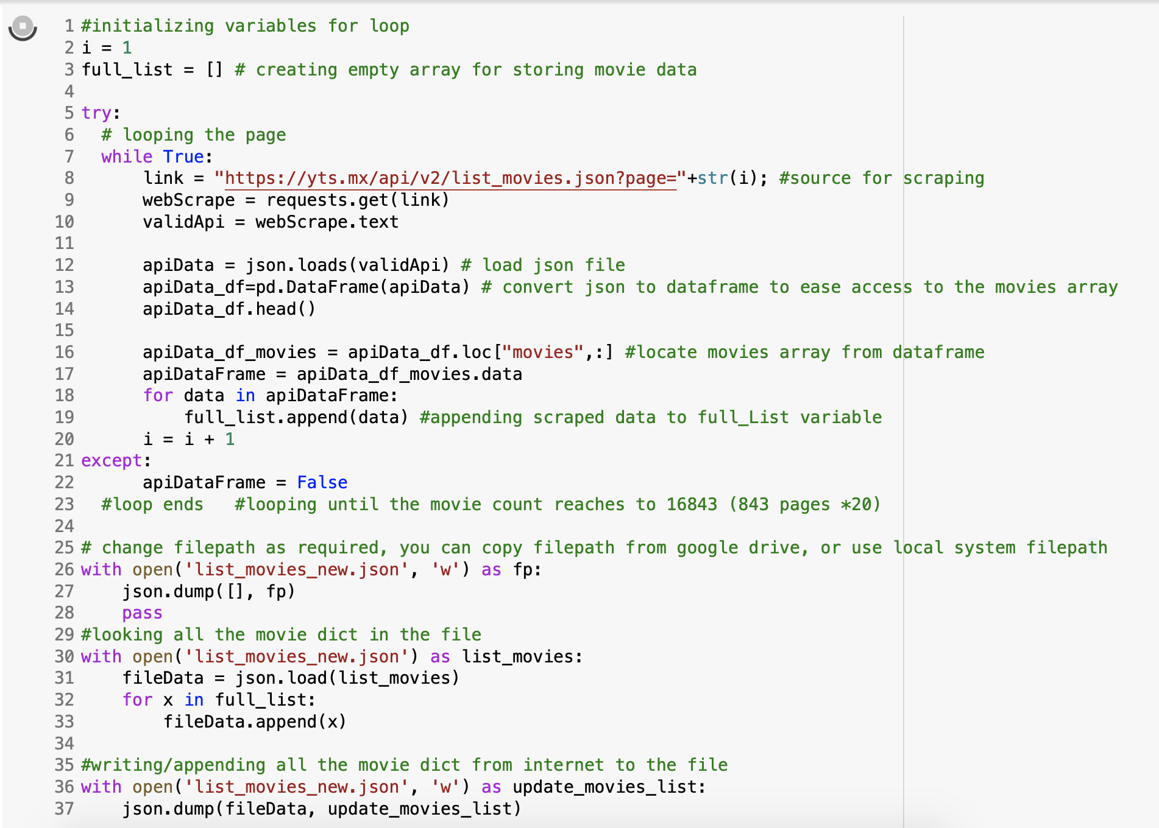
Code for scraping from yts API

Slide 18
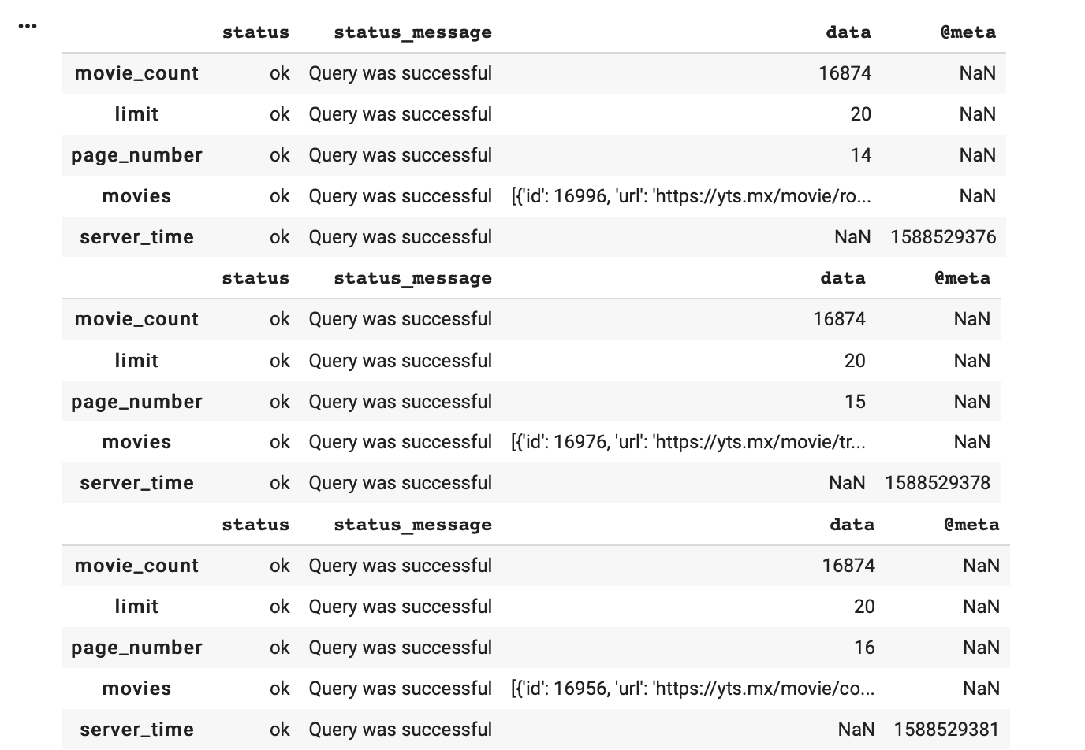

Sample of scraping
Targeting movies section

Slide 19
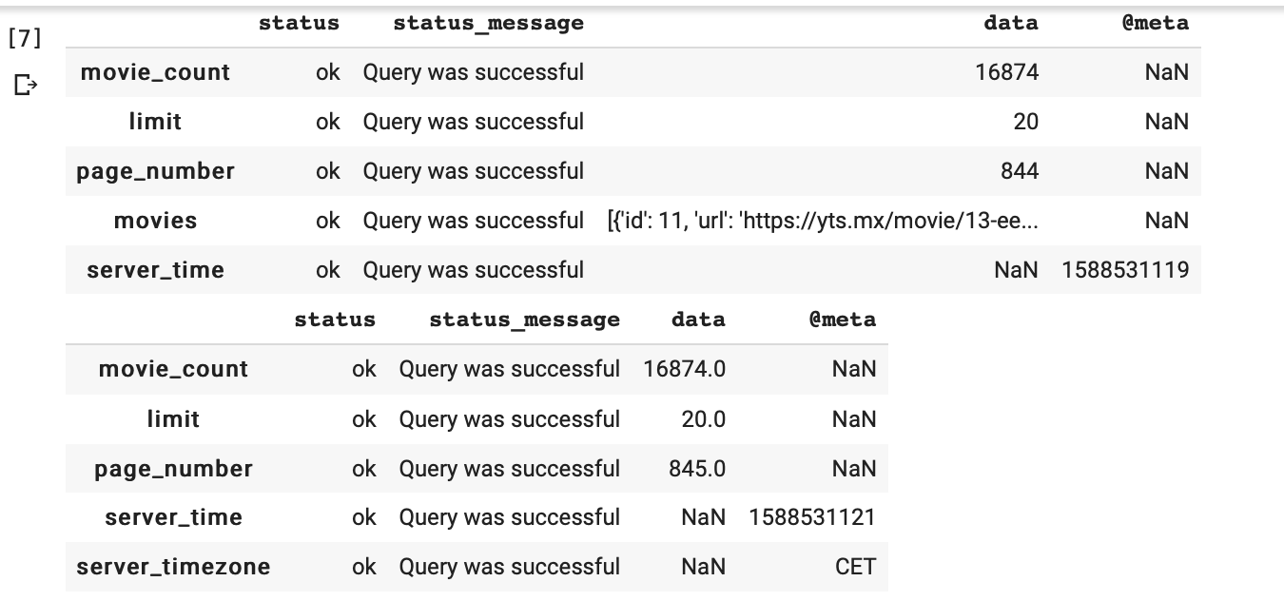

Sample of scraping
Finished at page 845 *20 data points

Slide 20
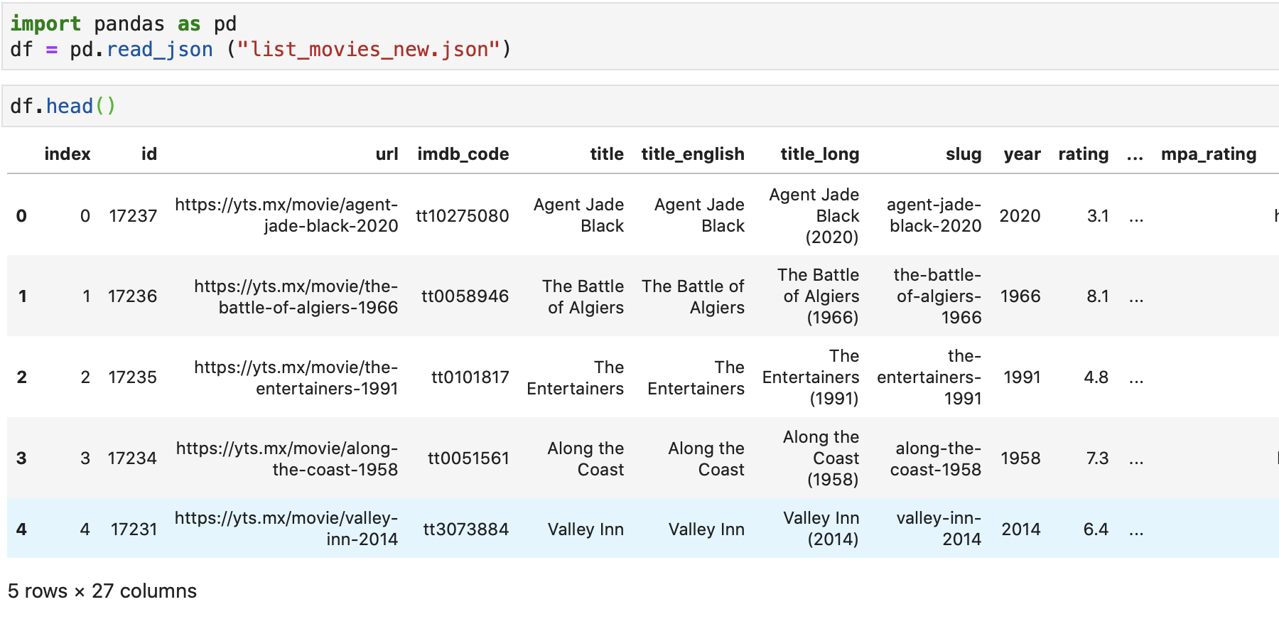
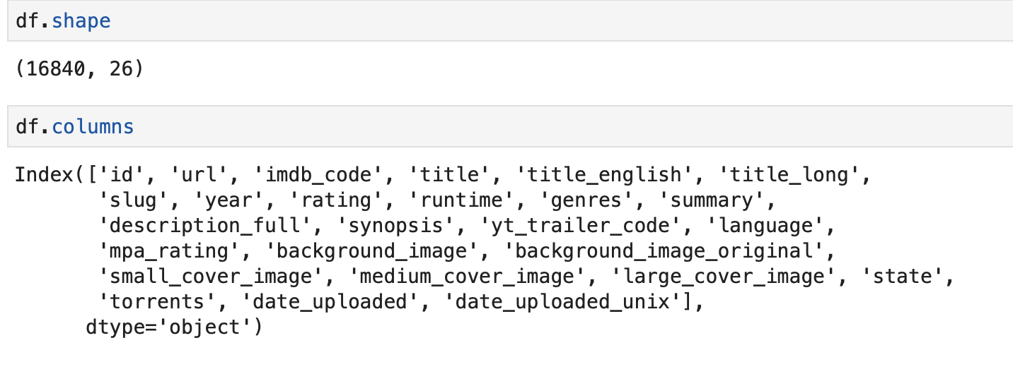
Read json file in python using pandas

Slide 21
Please check the jupyter notebook file for remaining codes

